Slide 2
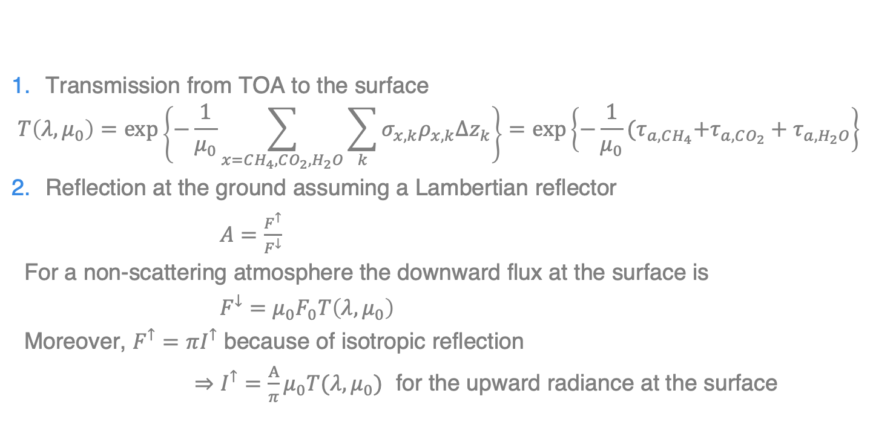
Non-scattering Radiative Transfer (3 steps to go)
Transmission from TOA to the surface
$$T\left(λ,μ_{0}\right)=\exp\left\{−\frac{1}{μ_{0}}\sum_{x=CH_{4},CO_{2},H_{2}O}{\sum_{k}{σ_{x,k}ρ_{x,k}Δz_{k}}}\right\}=exp\left\{−\frac{1}{μ_{0}}{(τ}_{a,CH_{4}}+τ_{a,CO_{2}}+τ_{a,H_{2}O}\right\}$$
Reflection at the ground assuming a Lambertian reflector
$A=\frac{F^{↑}}{F^{↓}}$
For a non-scattering atmosphere the downward flux at the surface is
$F^{↓}=μ_{0}F_{0}T\left(λ,μ_{0}\right)$
Moreover, $F^{↑}=πI^{↑}$ because of isotropic reflection
⇒ $I^{↑}=\frac{A}{π}μ_{0}T(λ,μ_{0})$ for the upward radiance at the surface

Slide 3

Non-scattering Radiative Transfer (3 steps to go)
Transmission from the surface to TOA along the instrument LOS is $T\left(λ,μ_{v}\right)$ and so we get the radiance
$I^{↑}=\frac{A}{π}μ_{0}T(λ,μ_{0})$ $T\left(λ,v\right)=\frac{A}{π}μ_{0}T(λ,μ_{eff})$ with $\frac{1}{μ_{eff}}=\frac{1}{μ_{0}}+\frac{1}{μ_{v}}$

Slide 4
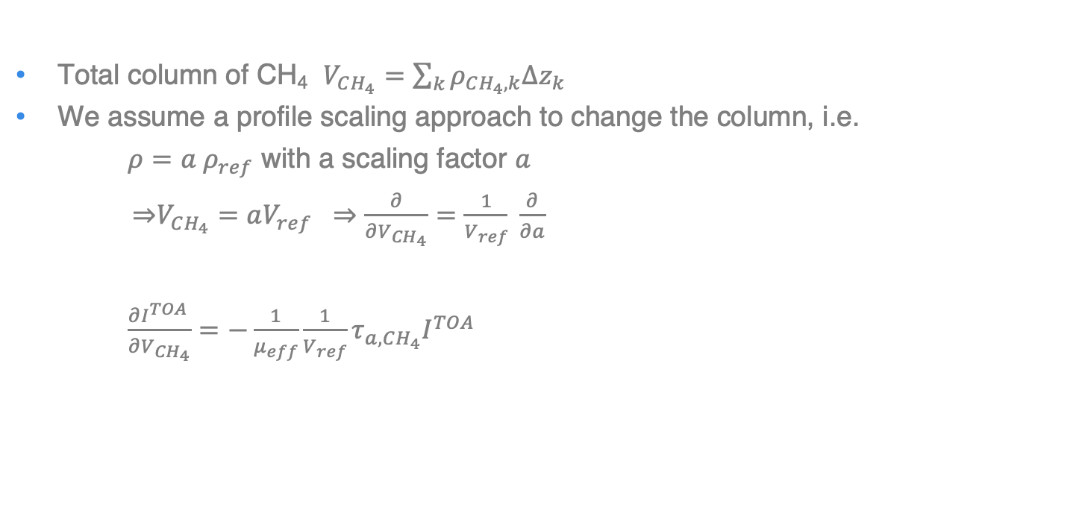
Derivative with respect to total vertical column of CH4
Total column of CH₄ $V_{CH_{4}}=\sum_{k}{ρ_{CH_{4},k}Δz_{k}}$
We assume a profile scaling approach to change the column, i.e.
$ρ=a ρ_{ref}$ with a scaling factor $a$
⇒$V_{CH_{4}}=aV_{ref} ⇒\frac{∂}{∂V_{CH_{4}}}=\frac{1}{V_{ref}} \frac{∂}{∂a}$
$\frac{∂I^{TOA }}{∂V_{CH_{4}}}=−\frac{1}{μ_{eff}}\frac{1}{V_{ref}}τ_{a,CH_{4}}I^{TOA}$

